Slide 1
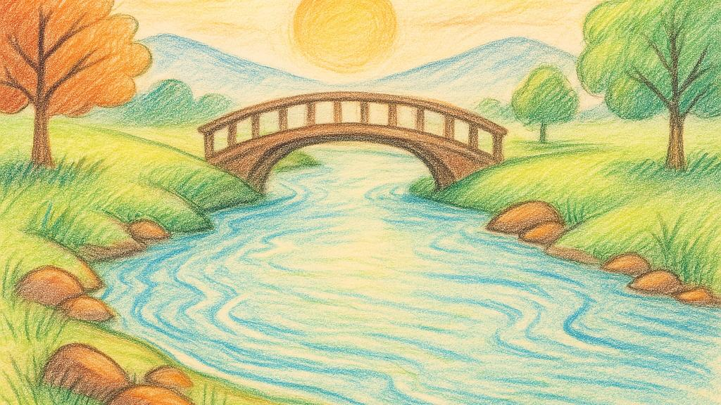
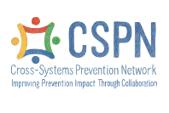
Understanding Upstream Prevention
Through the River Story
When we build upstream, we build safer, stronger futures for all.
Notes:
Welcome! This presentation introduces a simple way to talk about prevention using the River Story. A powerful visual that helps explain how we can support healthy futures by acting early.
Whether you're new to prevention or have been in the field for years, this approach can help us start meaningful conversations in our communities, in a way that's clear, hopeful, and easy to relate to.

Slide 2
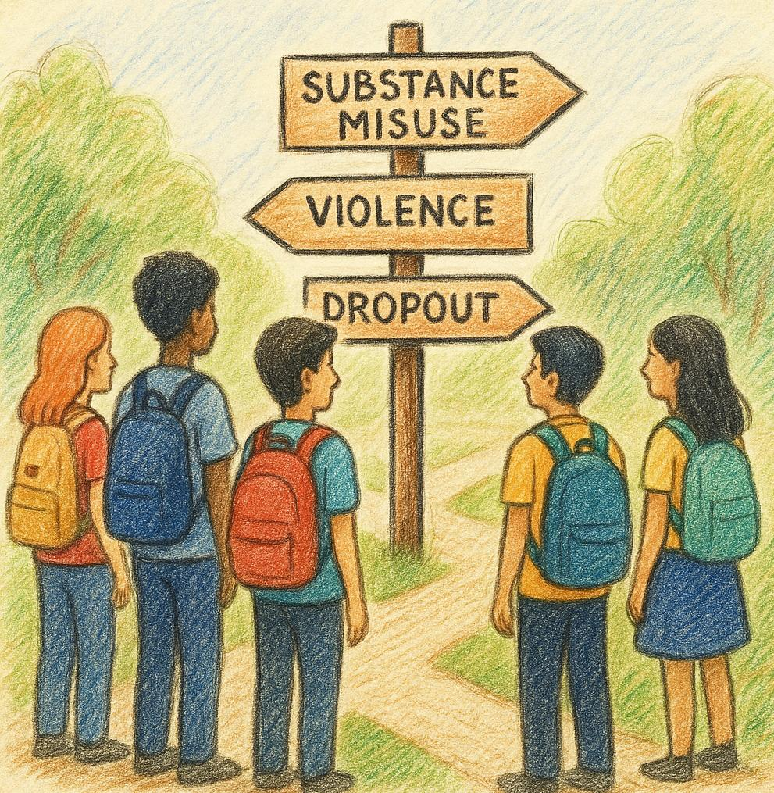

Building a Brighter Future with Prevention
Supporting Youth & Families Where They Are
Challenges We're Working to Prevent:
•Substance Misuse
•Delinquent behavior
•Teen Pregnancy
•School Disconnection & Dropout
•Exposure to Violence
•Emotional Distress (e.g, Depression & Anxiety)
Notes:
When people hear the word prevention, they often think about stopping one specific problem, like substance misuse. But prevention is much broader.
We're working to support youth and families in ways that help them avoid a wide range of challenges. Things like school disconnection, emotional distress, or exposure to violence. These are complex issues that don’t just affect one person; they impact whole communities.
We know the earlier we act and the more we invest in building up supports, the more likely we are to help young people stay on a path toward health, connection, and opportunity.

Slide 3
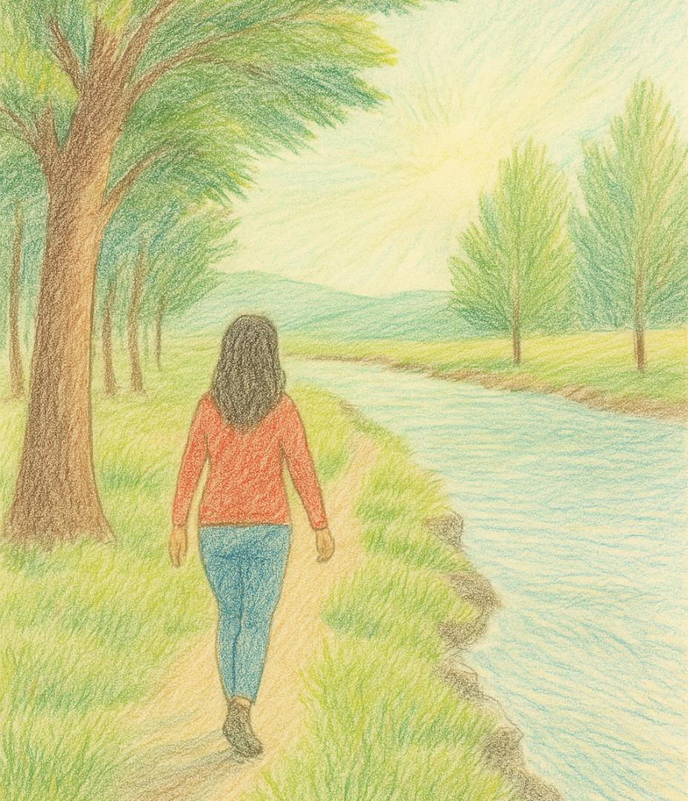
Upstream Prevention
This approach requires us to walk upstream
to find out how and why kids are ending up in the river.
This is where prevention starts:
Before harm happens.
Notes:
Upstream prevention asks us to go back, to walk upstream and ask: What’s pushing kids into the river in the first place?’
This means noticing the conditions, the gaps, and the barriers that young people and families face and working to change those early on. Prevention isn't just about stopping something; it’s about starting something better.
Upstream prevention is where change begins before harm happens, while we still have the most opportunity to build support, resilience, and connection.

Slide 4
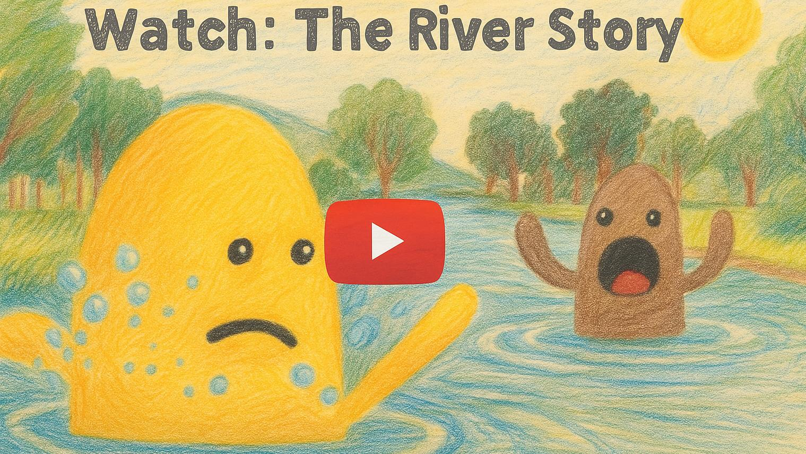

Notes:
Before we go any further, let’s take a minute to watch a short animated video called The River Story. It’s a creative way to show why prevention matters and what we mean by going upstream.
As you watch, think about what this might look like in your own community. What are the things we’re responding to and what might be causing them further upstream?
[If presenting live: You can now play the video — or share the link for groups to view on their own.]
Video link https://www.youtube.com/watch?v=vpJ4h8sxOJg

Slide 5
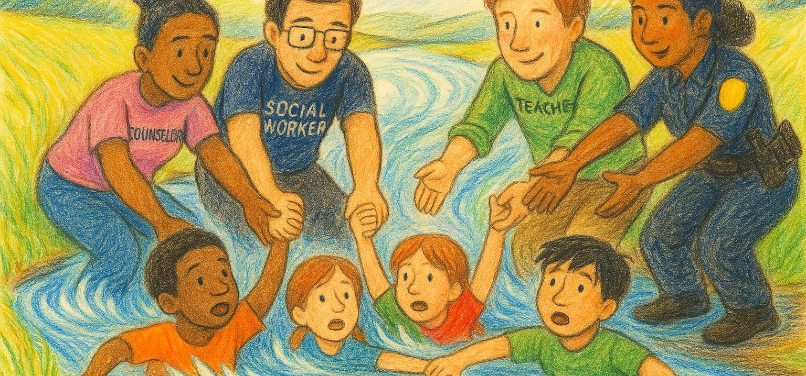
We have many caring systems already working hard to pull the children out of the river, after they’ve fallen in.
What if we all worked together to reduce how many children fall in?
Notes:
We already have amazing professionals working hard every day, counselors, social workers, teachers, law enforcement, doing all they can to help children and families in crisis.
But what if we worked together before those problems happened? What if we focused not only on pulling kids out of the river but also on preventing them from falling in at all?
That’s the heart of upstream prevention: building safe, supportive environments where children and families can thrive.

Slide 6
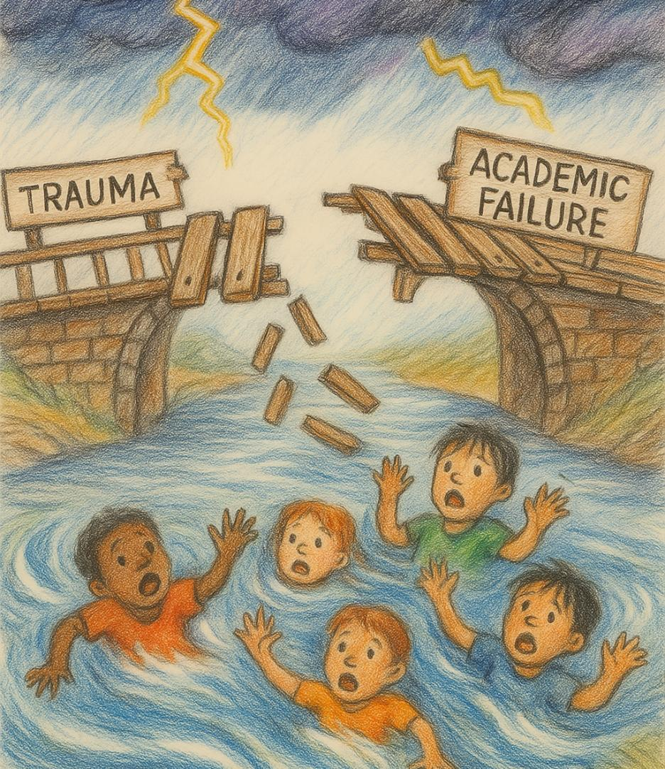
Risk & Protective Factors
Some experiences remove the planks that help kids cross life’s challenges safely.
Others help rebuild those planks—these are protective factors.
When planks are missing, kids may face:
• Disconnection from school
• Family stress
• Academic struggles
• Emotional distress
Prevention helps restore the planks that keep youth supported and on track.
Notes:
Think of every child walking across a bridge each plank is something that helps them succeed: connection, support, belonging, opportunity.
Sometimes, life events or systems remove those planks, things like trauma or barriers in school can make it harder to move forward safely.
Protective factors help rebuild that bridge. They don’t eliminate every challenge, but they give kids stronger footing.
That’s the role of prevention: not to fix youth, but to strengthen the support around them so they don’t have to walk alone or fall through the cracks.

Slide 7
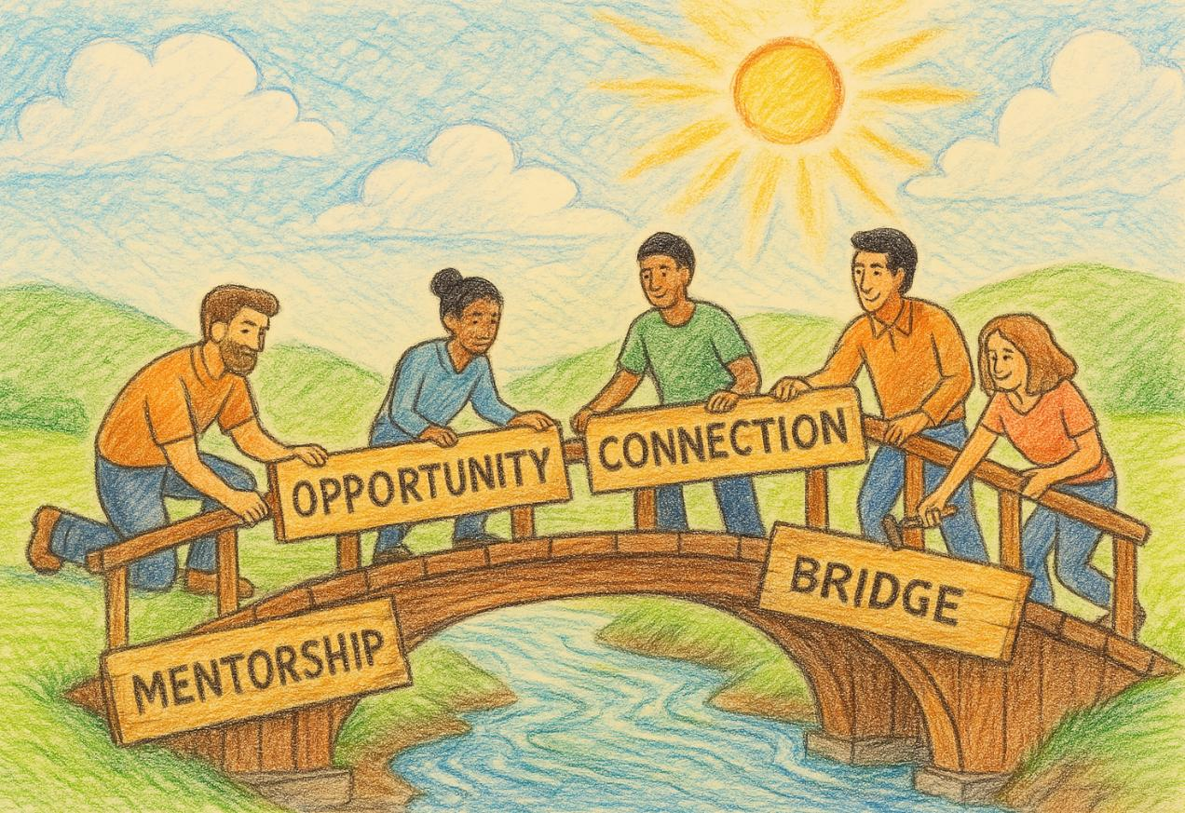
Protective Factors Build Strong Bridges
These planks, like connection, support, and opportunity, help kids stay on solid ground.
Protective factors include:
• Strong family bonds
• Clear rules and guidance
• Caring schools and programs
• Positive friendships
• Chances to contribute and feel valued
Together, we strengthen the bridge before kids fall in. Everyone has a role in prevention.
Notes:
Prevention doesn’t always look like a program or a campaign; it’s the everyday supports that help kids feel safe, connected, and confident.
When we talk about protective factors, we’re talking about the things that build strong bridges for young people, like supportive relationships, consistent boundaries, and opportunities to grow.
The best part? Everyone can play a role: families, teachers, mentors, neighbors. Prevention is community work.
And when we work together, we make it less likely that kids fall into crisis in the first place. We make the path ahead stronger.

Slide 8
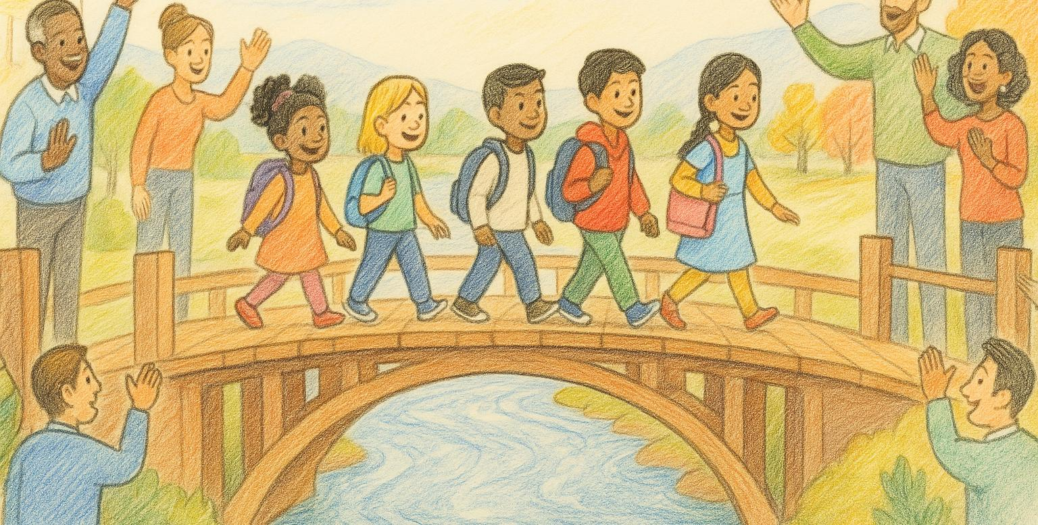
This is what prevention looks like
Safe, supported, and on the right path, because of prevention
Notes:
When we invest in prevention, this is the result: kids who feel safe, supported, and able to thrive.
They’re not just staying out of trouble, they’re walking forward with confidence, with people around them cheering them on.

Slide 9
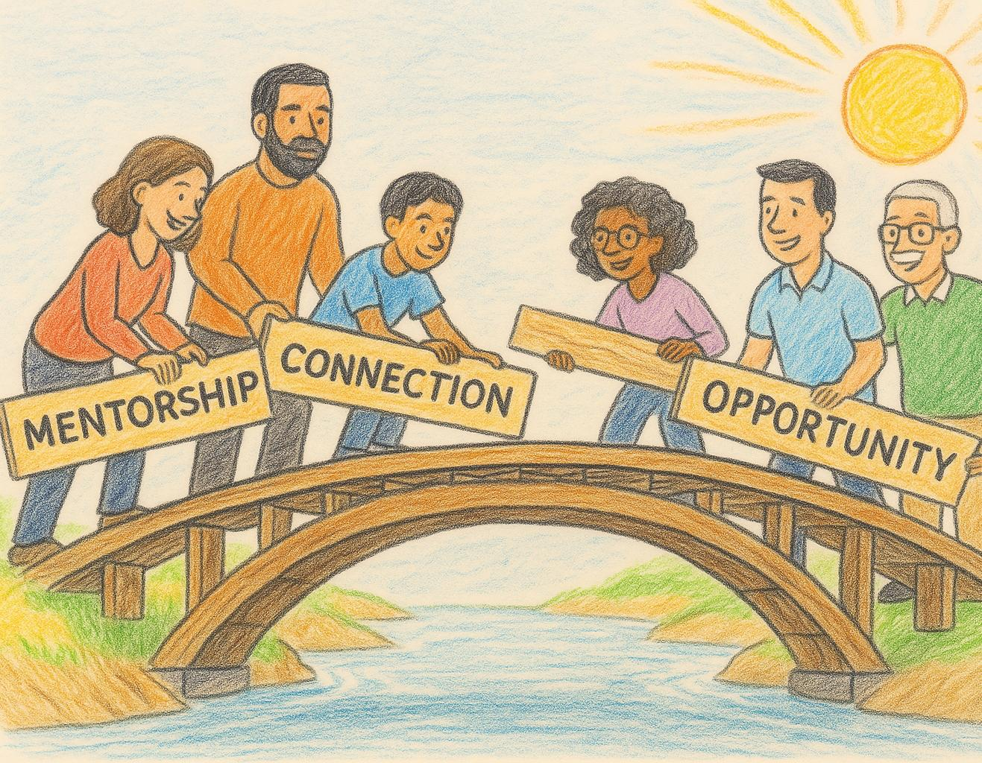
Building Stronger Bridges
Through increasing protective factors and reducing risks, we strengthen the bridge that helps children safely cross over to adulthood, without falling in.
Not all bridges are broken, but all can be strengthened.
How we make lasting change
Notes:
Prevention isn’t just about avoiding problems. It’s about building strong foundations for success and belonging. That’s what we’re all working toward.
And it’s possible when we all play a part.

Slide 10
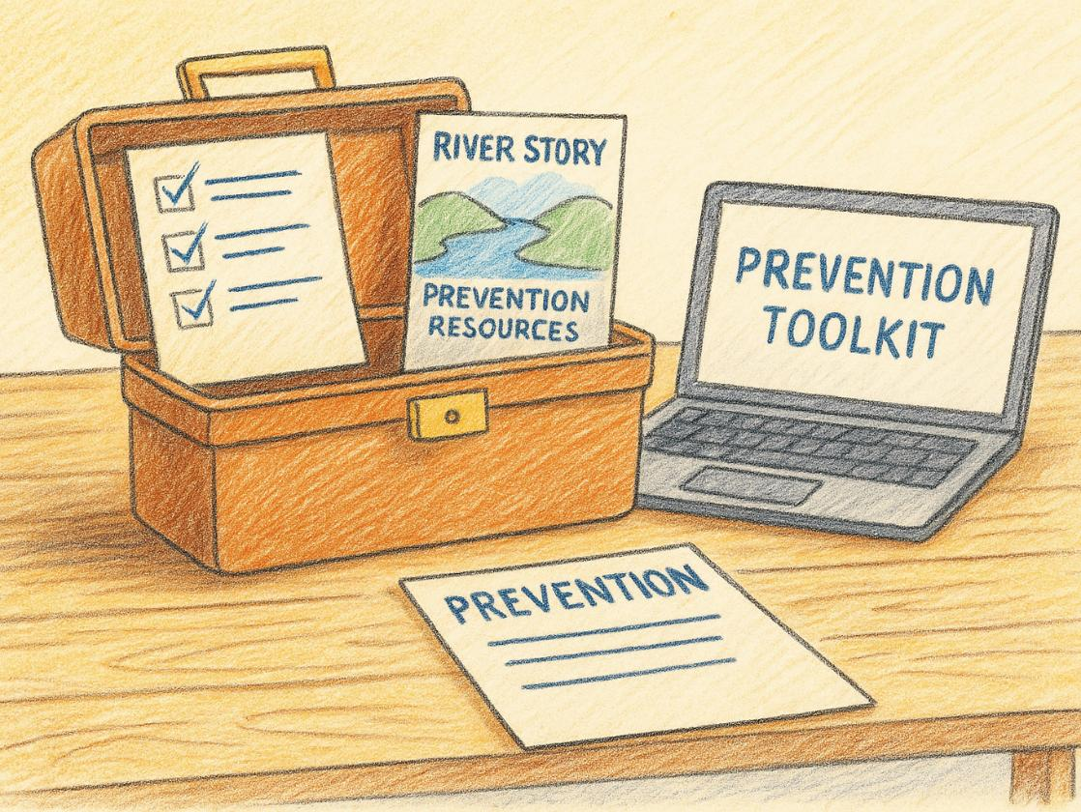

Your Prevention Toolkit
Everyone has a role to play in prevention.
Use this toolkit to share the River Story and spark meaningful conversations.
Inside are slides, checklists, and messaging to help others see how prevention builds stronger futures.
Download the slides. Share the story. Start the conversation.
Notes:
Download the slides: Cross-Systems Prevention Network (CSPN) · PAPrevention

Slide 11
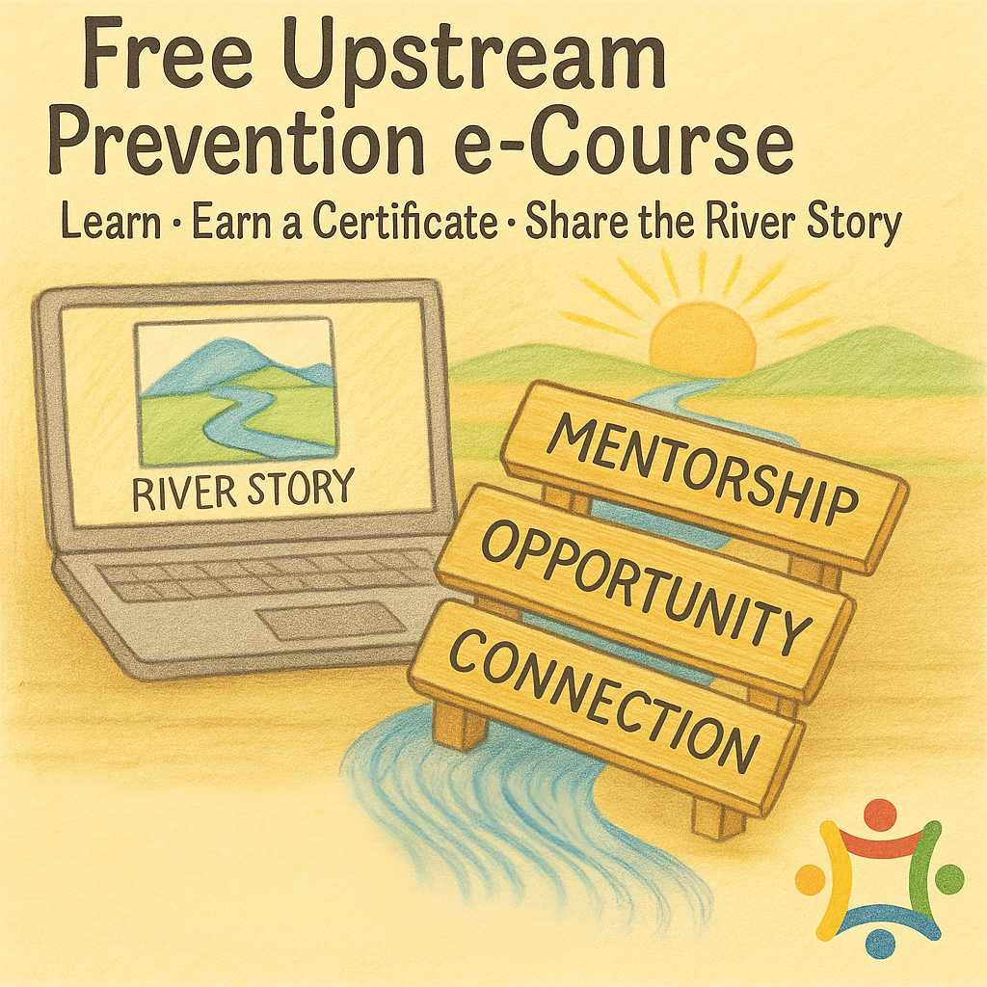
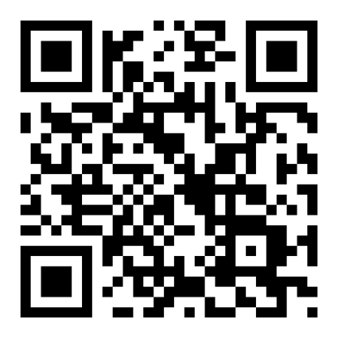
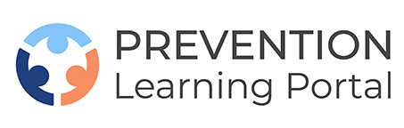
Want to learn more? Here’s a free, self-paced course that expands on these ideas
Scan to enroll now
Notes:
Free Prevention Resource: Welcome to the Portal | Prevention Learning Portal
The PLP offers FREE online courses that are self-paced, prevention-focused learning opportunities. Many qualify for continuing education credits.

